Slide 1
Inheritance – Types - Derived Class Constructors- Issues in Inheritance – Virtual base Class
– Polymorphism – Virtual functions – Pure virtual functions.

Slide 2
Class Inheritance
Derive new classes from the old ones
Supports the following:
You can add functionality to an existing class. For example, given a basic array class, you could add arithmetic operations.
You can add to the data that a class represents. For example, given a basic string class, you could derive a class that adds a data member representing a color to be used when displaying the string.
You can modify how a class method behaves. For example, given a Passenger class that represents the services provided to an airline passenger, you can derive a FirstClassPassenger class that provides a higher level of services.
The above can be performed with the object code of the old ones

Slide 3
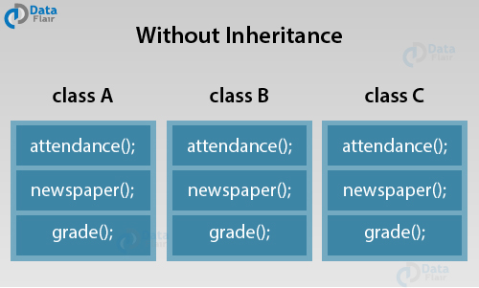
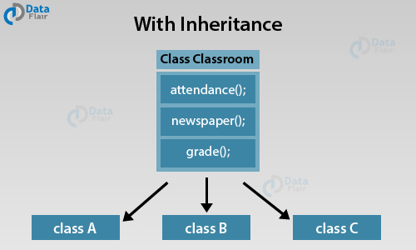
Example
Classes in a school

Slide 4
Importance
It drastically reduces code redundancy as it allows the derived class to inherit all the properties of the base class, leaving no room for duplicate data to achieve the same task.
Inheritance in C++ offers the feature of code reusability. We can use the same fragment of code multiple times. To sum it up, inheritance helps us save our development time, maintain data in a simplified manner and gives us the provision to make our code extensible.
It increases the code reliability by providing a definite body to the program.
The transitive nature of inheritance makes things much easier for us.
Let us first try to understand what transitive means.
If a = b and b = c, by transitive law, a =c.
Similarly, if class B inherits all the properties of class A and class C inherits all the properties of class B, then class C has properties of both classes A and class B.

Slide 5
Syntax
class <new_class_name>:<access_specifier> <old_class_name>
Access specifier – decides the visibility/ access specifier of the old class members in the new class

Slide 6
Base and Derived Classes, Inheritance types
When one class inherits from another, the original class is called a base class, and the inheriting class is called a derived class.
Inheritance types
Based on structure of inheritance
Single inheritance
Multiple inheritance
Hierarchical inheritance
Multilevel inheritance
Hybrid inheritance
Based on visibility modes
public inheritance
private inheritance
protected inheritance
Ref: https://data-flair.training/blogs/inheritance-in-cpp/

Slide 7
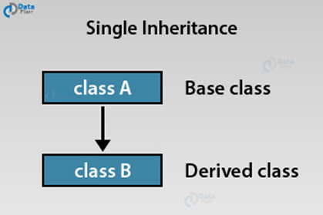
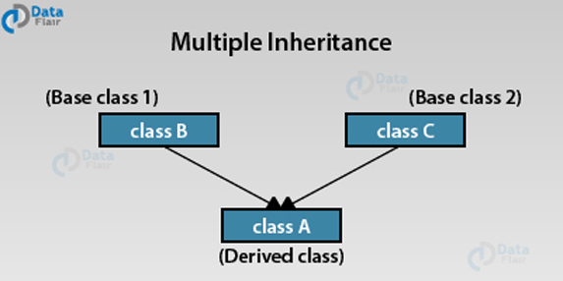
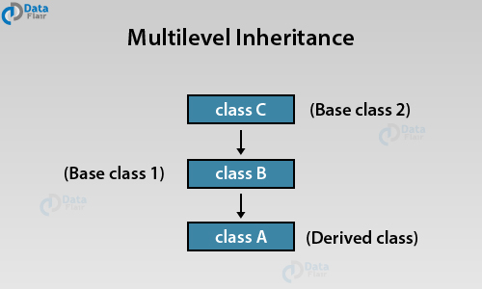
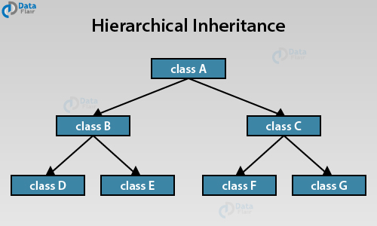
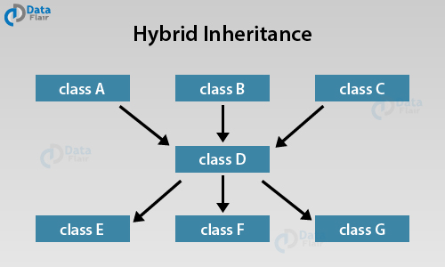
Inheritance types based on structure (the count of base and derived classes and levels)

Slide 8
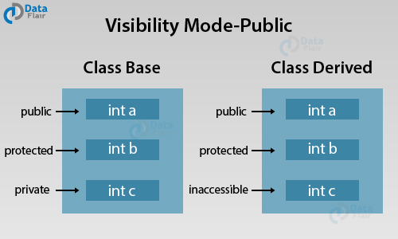
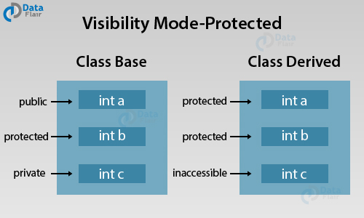
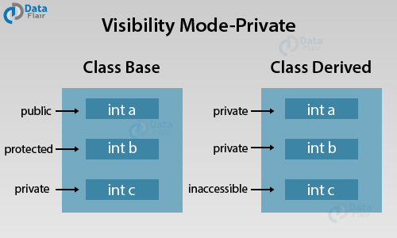
Types of inheritance based on visibility mode
The public visibility mode allows the derived class to access the public and protected but not private members of the base class
The protected visibility mode allows the derived class to access the public and protected members of the base class in the protected mode.
The private visibility mode allows the derived class to access the public and protected members of the base class privately.

Slide 9
Elements that cannot be inherited
The constructor and destructor of the parent class cannot be inherited.
The assignment operator cannot be inherited
Friend function and friend classes of the parent class cannot be inherited.

Slide 10
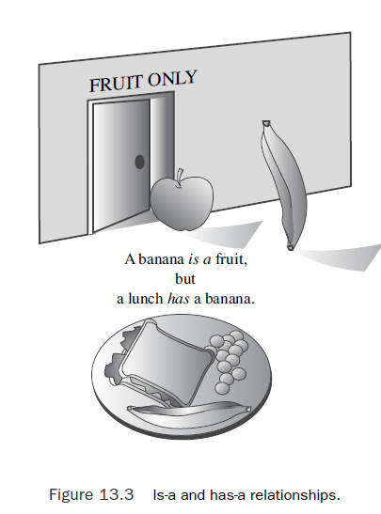
Object Relationships vs visibility control types
Public Inheritance – is a relationship between the parent and the child class objects
object of a derived class should also be an object of the base class
Protected (Inheritance) – improves access for derived to access base class private members
Private Inheritance – has a relationship between the parent and the child class objects

Slide 11
Examples
Ref: https://www.tenouk.com/Module16a.html

Slide 12
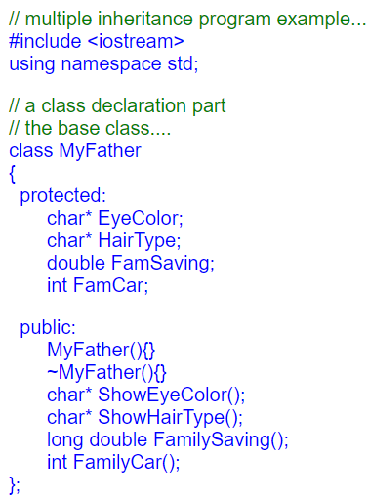
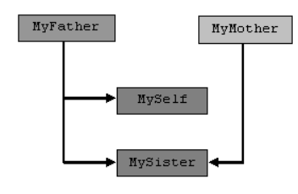
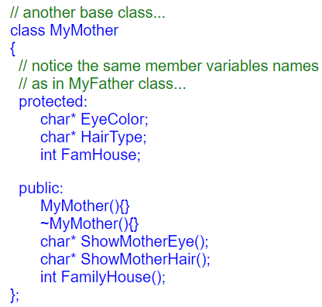
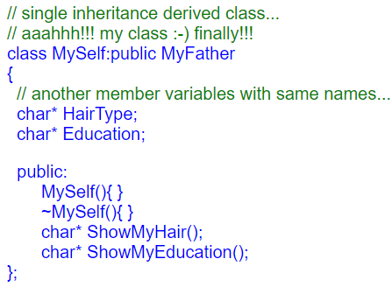
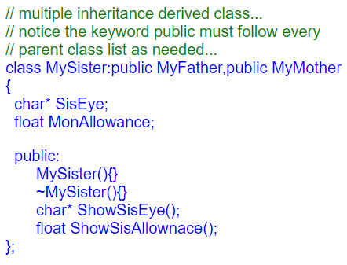
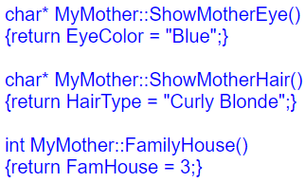
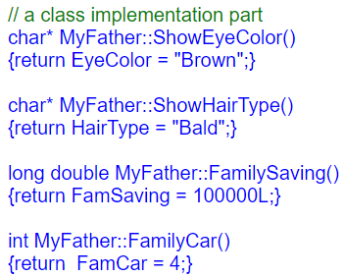
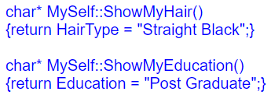
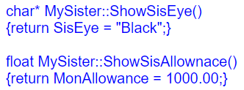

Slide 13
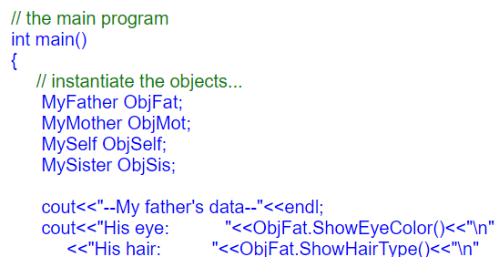
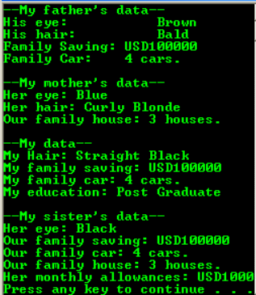
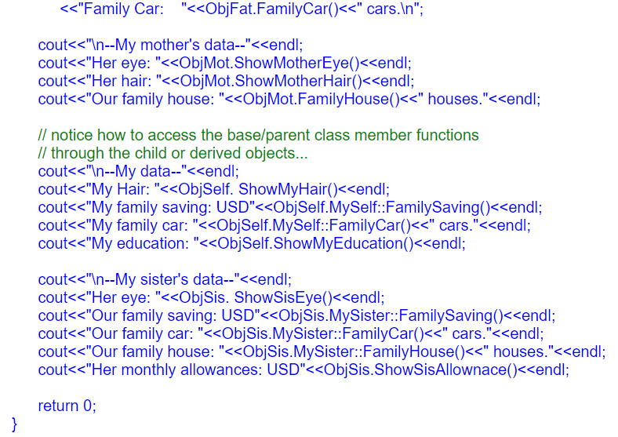
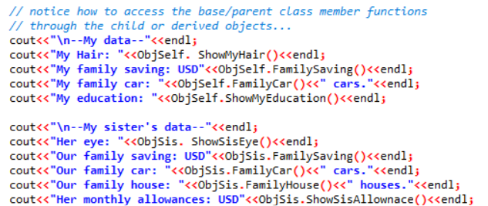

Slide 14
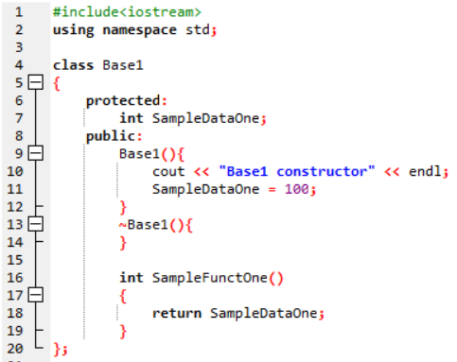
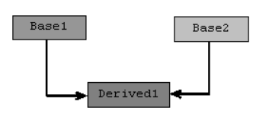
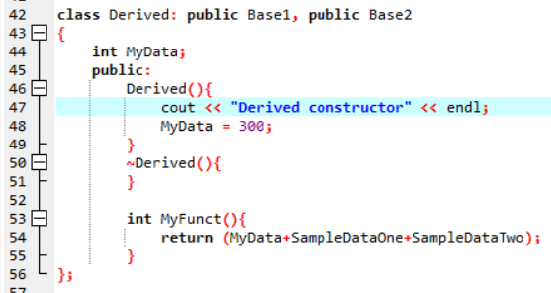
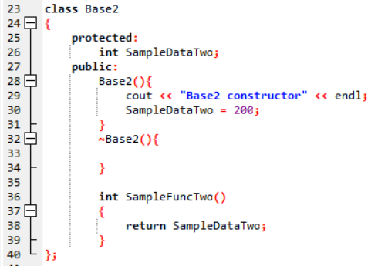
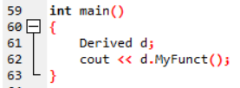
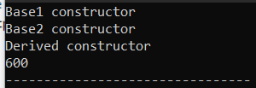

Slide 15
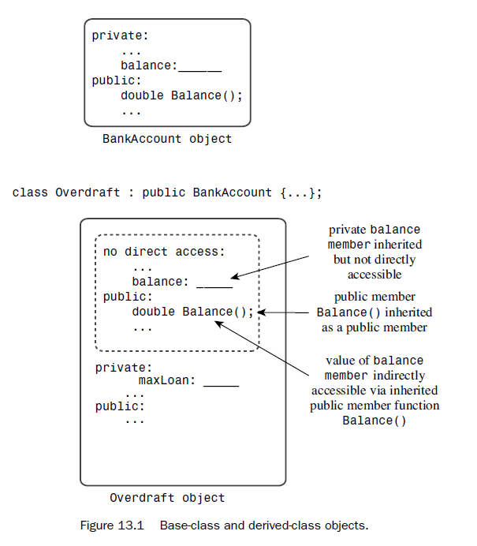
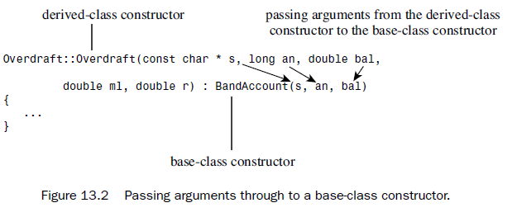
Derived class constructor
The constructors have to provide data for the new members, if any, and for the inherited members.
The protected and public attributes of the base class can be set directly by the derived class constructor
The private attributes of the base class has to be set through public methods by the derived class constructor
Conceptually, that means the base-class object should be constructed before the program enters the body of the derived-class constructor. (performed using member initialization syntax in C++)
Overdraft::Overdraft(const char *s, long an, double bal, double m1, double r) : BankAccount(s, an, bal), maxLoan(m1), rate(r){
}

Slide 16
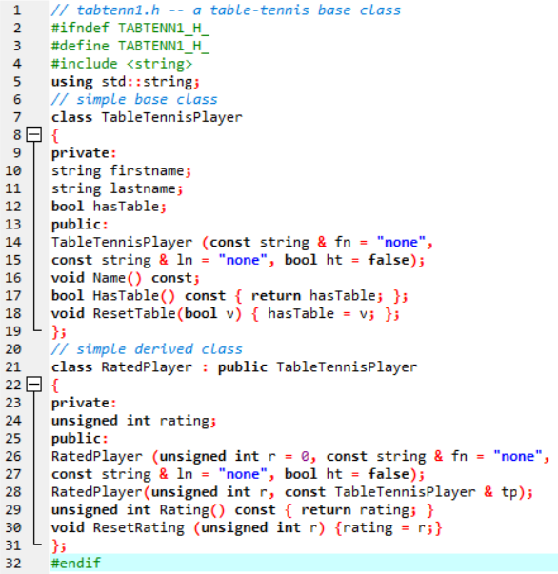
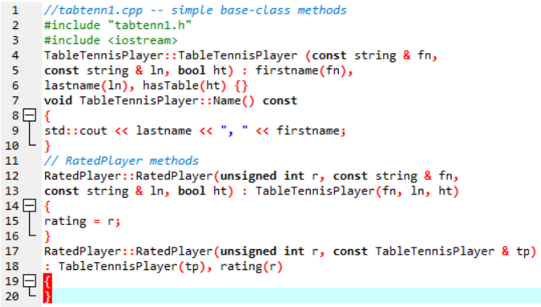

Slide 17
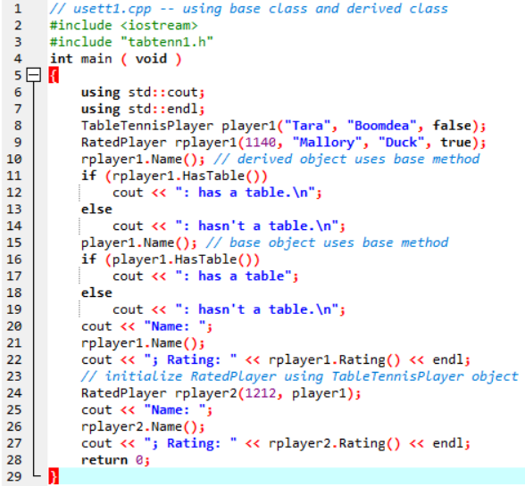
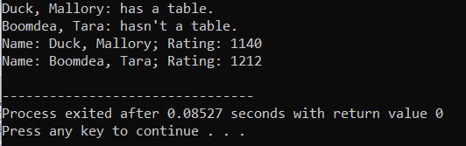

Slide 18
Relationship between base and derivative objects, references and pointers
RatedPlayer rplayer1(1140, "Mallory", "Duck", true);
rplayer1.Name(); // derived object uses base method
RatedPlayer rplayer1(1140, "Mallory", "Duck", true);
TableTennisPlayer & rt = rplayer;
TableTennisPlayer * pt = &rplayer;
rt.Name(); // invoke Name() with reference
pt->Name(); // invoke Name() with pointer
TableTennisPlayer player("Betsy", "Bloop", true);
RatedPlayer & rr = player; // NOT ALLOWED
RatedPlayer * pr = player; // NOT ALLOWED

Slide 19
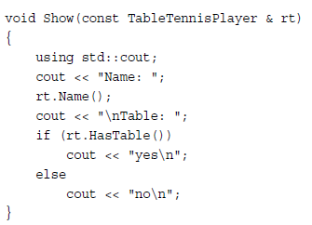
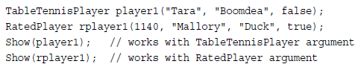
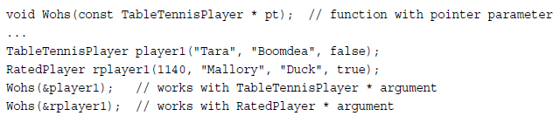

Slide 20
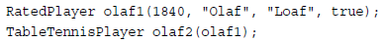
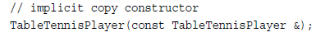
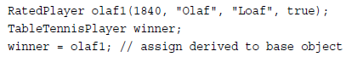
Initialising the base class object from derived object
Assigning a derived class object to a base class object
Uses the following function

Slide 21
Polymorphic Public Inheritance
Objects of the derived class can use the base-class methods without change.
But you can encounter situations in which you want a method to behave differently for the derived class than it does for the base class.
That is, the way a particular method behaves may depend on the object that invokes it.
Two key mechanisms
Redefining base-class methods in a derived class
Using virtual methods
Qualifier name for methods (member functions)
<class_name> :: <function_name>
Virtual keyword
Used for the functions of the base class that have different definitions in the derived class
Required for run time polymorphism

Slide 22
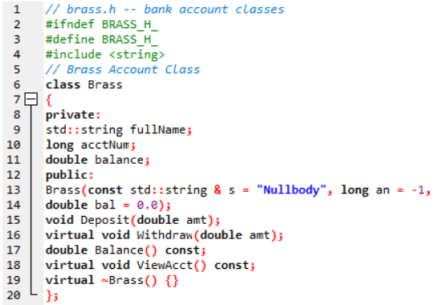
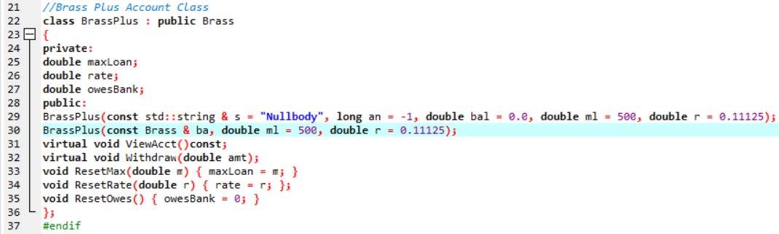

Slide 23
Virtual vs Non virtual
If you don’t use the keyword virtual, the program chooses amethod based on the reference type or pointer type.
// behavior with non-virtual ViewAcct()
// method chosen according to reference type
Brass dom("Dominic Banker", 11224, 4183.45); //base class object
BrassPlus dot("Dorothy Banker", 12118, 2592.00); //derived class object
Brass & b1_ref = dom;
Brass & b2_ref = dot;
b1_ref.ViewAcct(); // use Brass::ViewAcct()
b2_ref.ViewAcct(); // use Brass::ViewAcct()
If you do use the keyword virtual, the program chooses a method based on the type of object the reference or pointer refers to.
// behavior with virtual ViewAcct()
// method chosen according to object type
Brass dom("Dominic Banker", 11224, 4183.45);
BrassPlus dot("Dorothy Banker", 12118, 2592.00);
Brass & b1_ref = dom;
Brass & b2_ref = dot;
b1_ref.ViewAcct(); // use Brass::ViewAcct()
b2_ref.ViewAcct(); // use BrassPlus::ViewAcct()

Slide 24
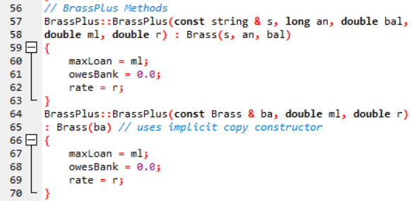
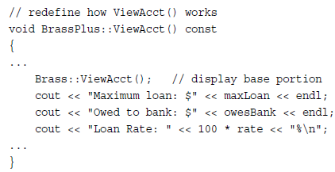
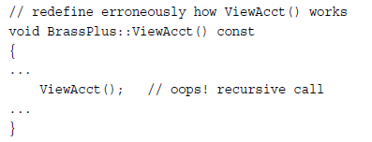
Accessing private members of the base class
Using member initialisation syntax - constructor functions
Using public functions of the base class - Other functions

Slide 25
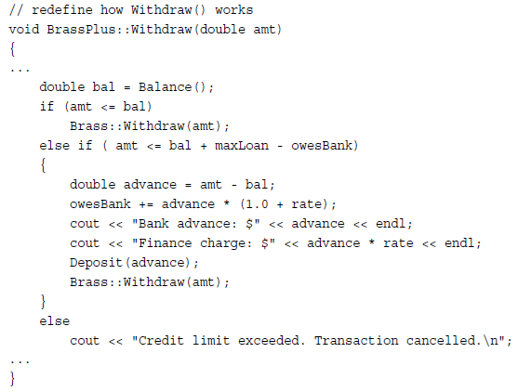
Accessing private members of the base class contd…
Base class method not redefined in the derived class – Brass:: not required
Base class method not redefined in the derived class – Brass:: not required

Slide 26
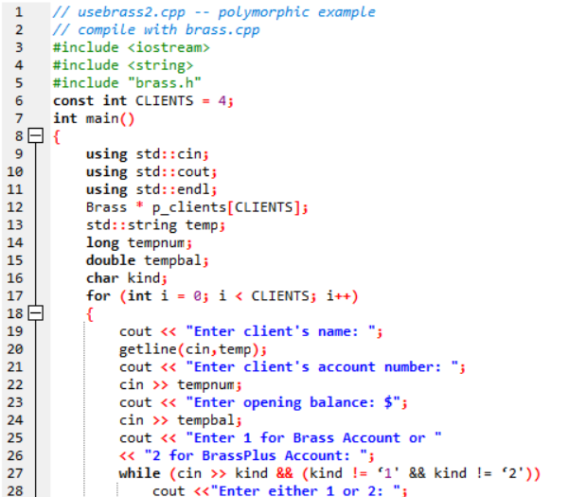
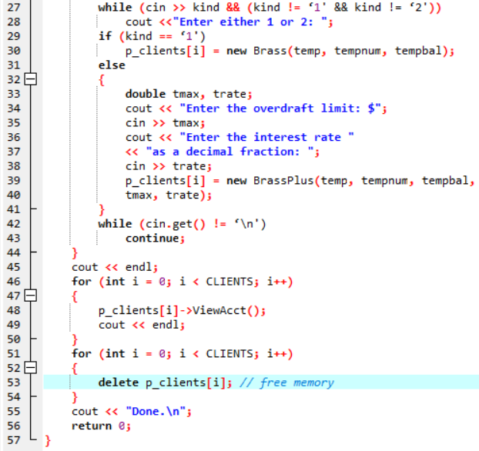
POLYMORPHIC ASPECT
VIRTUAL DESTRUCTOR ENSURES THE CORRESPONDING DESTRUCTOR IS CALLED (BASED ON THE OBJECT THE POINTER POINTS TO)

Slide 27
Static vs dynamic binding
Binding:
Interpreting a function call in the source code as executing a particular block of function code is termed binding the function name.
C – Binding is done by compiler using function name (Static binding)
C++ - Function overloading – binding is done by compiler using function name and arguments (Static binding)
C++ - Virtual functions invocation using reference / pointer– binding takes place during run time – Dynamic binding
Dynamic binding
Performed by maintaining a hidden pointer pointing to table of virtual functions maintained for the base and derived classes for each object
Non-virtual functions of a class – static binding (less processing overhead at run-time, conceptual model doesnot require a redefinition in the derived class)

Slide 28


Slide 29
Key points – Virtual functions
Beginning a class method declaration with the keyword virtual in a base class makes the function virtual for the base class and all classes derived from the base class, including classes derived from the derived classes, and so on.
If a virtual method is invoked by using a reference to an object or by using a pointer to an object, the program uses the method defined for the object type rather than the method defined for the reference or pointer type. This is called dynamic, or late, binding. This behavior is important because it’s always valid for a base-class pointer or reference to refer to an object of a derived type.
If you’re defining a class that will be used as a base class for inheritance, you should declare as virtual functions the class methods that may have to be redefined in derived classes.
Constructors – can’t be virtual (appropriate constructor – invoked when object is instantiated)
Destructor – virtual for a base class with virtual functions (appropriate destructor should be called when an object is deleted through reference / pointer)

Slide 30




Friends
Non member functions
Cannot be virtual
No redefinition of a function in a class
Most recent in the inheritance hierarchy is used
Redefinition hides methods
Redefinition in derived class hides the functions with same name (irrespective of signature) in the base classes
Rule to be followed
Redefinition should not alter the input and return type
Exception: Return of base class reference can be replaced by derived class reference
If there are overloaded functions in base class – each of the overloaded should be redefined in the derived class
Hides function with arguments
Does not overload

Slide 31





Protected Members
Private to other classes
Cannot be accessed directly using objects by other classes
Public to the derived classes
class Brass
{
private:
double balance;
. . . .
};
Adv: of protected access: Ease of access
Disadv: Security issues (Derived class can create public method for other objects to modify the attribute)

Slide 32



Issue with inheritance
Some attributes/ methods of a base class can conflict with that of the derived class
Example: Ellipse and Circle
Share a is a relationship
Soln 1: Separate class – donot capture relationship
Problem: Many methods in base class are not required by the derived class
Soln 2: Creating a separate class which has the common elements of both the classes – abstract class

Slide 33

Abstract base class
All methods need not be implemented by abstract base class
Method that are not implemented – pure virtual function
Indicated by =0 at the end of the function header
Objects cannot be created for an abstract base class
Pure virtual function – may also have a definition
ABC – atleast one virtual function
Virtual function with definition

Slide 34




Slide 35



Slide 36
Abstract base class approach
More systematic and disciplined approach
Classes that derive an abstract base class are enforced to provide implementations of the pure virtual functions that are not implemented by the abstract base class – A standard is set for component based programming paradigm
Concrete classes (non-abstract / instantiable) never serve as a base class – cleaner design with fewer complications

Slide 37
Inheritance and Dynamic Memory Allocation
Class with pointers and dynamic memory allocation – requires user defined copy constructors and destructors
For derived class that inherits a class with DMA
Need not required user defined constructors/destructors as base class constructors / destructors are invoked
When both base and derived classes have DMA
Base class destructor to release DM is called automatically
Copy constructor and assignment operator must invoke the base class counterparts in their implementation

Slide 38


EXAMPLE – INHERITANCE, FRIENDS, DMA

Slide 39



Slide 40




Slide 41



Slide 42
Class Design Review
Default constructor –
provided by compiler when no constructor is defined.
If any type of constructor is defined compiler does not provide.
Proper initialisation of variables and pointers
Copy constructor – for deep copying
Assignment Operators – When one object values are copied to another.
Other method considerations
Constructor – not inherited. As they are called when creating new objects. Cannot be called by existing objects
Destructor – virtual
Conversion – using constructors and conversion functions
Passing an object by value vs Passing a reference – Passing reference is more efficient as temporary objects are not created. To avoid the modification of the object passed, it can be received in a const formal argument
Returning object vs returning reference – Return by reference is more efficient, local variables cannot be returned by reference
Using const –
When used in an argument - ensures that the function does not modify the argument
When used at the end of a method header – ensures the method does not alter the state of the object

Slide 43


Public inheritance considerations
Is-a relationship consideration – choice of base and derived classes, creation of abstract classes
What’s not inherited – constructors, destructors, assignment operators
Assignment operator – to be provided in case of DMA in the class objects
Assigning derived class object to base class object can be handled
Assigning base class object to derived class object require converters (parameterised constructor) / separate operator function
Private vs protected – private (security) protected (speed)
Stroustrup, in his book The Design and Evolution of C++, indicates that it’s better to use private data members than protected data members but that protected methods are useful.
Virtual method – only for methods that are redefined.
Requires call be reference
Destructor – base class destructor should be virtual
Friend – not a member, hence not inherited
Friend to a derived class can access friend to a base class using dynamic cast

Slide 44
Using base class methods
A derived object automatically uses inherited base-class methods if the derived class hasn’t redefined the method.
A derived-class destructor automatically invokes the base-class constructor.
A derived-class constructor automatically invokes the base-class default constructor if you don’t specify another constructor in a member-initialization list.
A derived-class constructor explicitly invokes the base-class constructor specified in a member-initialization list.
Derived-class methods can use the scope-resolution operator to invoke public and protected base-class methods.
Friends to a derived class can type cast a derived-class reference or pointer to a base-class reference or pointer and then use that reference or pointer to invoke a friend to the base class.

Slide 45


Class function summary
Some can be inherited, and some can’t. Some operator functions can be either member functions or friends, and others can only be member functions.

Slide 46
Has a relationship
Classes with object members-private inheritance

Slide 47



Classes with object members

Slide 48


Slide 49



Slide 50





Slide 51

Classes with object members
Using Private Inheritance
Private Inheritance provides two nameless sub-objects as members

Slide 52

Using Private Inheritance

Slide 53



Slide 54


Slide 55


Slide 56
Containment Vs Private Inheritance
In general, you should use containment to model a has-a relationship.
You should use private inheritance if the new class needs to access protected members in the original class or if it needs to redefine virtual functions.

Slide 57

Protected Inheritance
Variation of private inheritance
Keyword protected is used when listing base class
Public and protected members of a base class become protected members of the derived class.
As with private inheritance, the (protected) interface for the base-class is available to the derived class but not to the outside world.
The main difference between private and protected inheritance occurs when you derive another class from the derived class. With private inheritance, this third-generation class doesn’t get the internal use of the base-class interface. (base->protected->derived1->private->derived2)
That’s because the public base-class methods become private in the derived class, and private members and methods can’t be directly accessed by the next level of derivation.
With protected inheritance, public base-class methods become protected in the second generation and so are available internally to the next level of derivation.

Slide 58
Types of inheritance based on visibility mode
The public visibility mode allows the derived class to access the public and protected but not private members of the base class
The protected visibility mode allows the derived class to access the public and protected members of the base class in the protected mode.
The private visibility mode allows the derived class to access the public and protected members of the base class privately.

Slide 59

Redefining Access with using
Particular base class member made available in a different class with a specified access

Slide 60

Multiple Inheritance
Methods has to be mentioned with scope resolution to avoid confusion when same methods are present in two or more parents

Slide 61
Summary
Reusing class
Derivation – is a relationship – public inheritance
Composition – has a relationship – private inheritance / protected inheritance
Redefining methods
Virtual function – run time polymorphism
Abstact base class design approach
Designing a model before developing components
Abstract base class – class with atleast one pure vitual function
Multiple inheritance – avoiding ambiguities – qualifier name

